Slide 1
OSCE 2016 April
RH AED

Slide 2
Case 1
65 years old lady. She had history of DM, HT and chronic renal failure. She claimed to have pain on the left leg for two days. She denied of any injury.

Slide 4
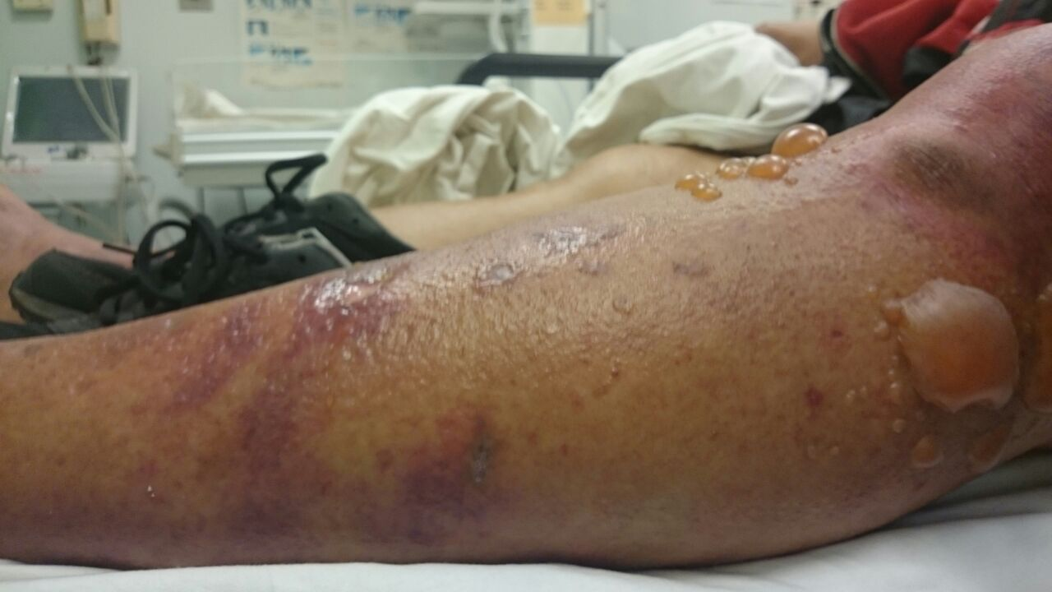

Slide 5
Question 1.1 What are the signs of the patient?
Question 1.2 What is the diagnosis ? Is there any classification?
Question 1.3 Is there any diagnostic scoring system to distinguish this condition from other similar conditions?
Question 1.4
What is the management plan in emergency room?

Slide 6
What are the signs of the patient?
swelling of infected limb, erythema, dusky discoloration and bullae ( positively correlation with amputation and mortality rates)
Notes:
other signs including tenderness extends beyond the apparent involved area, margins of involvement is indistinct, crepitus. Fever is only in 40% of cases. lymphangitis is rarely seen.

Slide 7
What is the diagnosis ? Is there any classification?
necrotizing fasciitis. classification based on the microbiology
type 1 polymicrobial. It affect mainly truck, abdomen and perineum
type 2 monomicrobial infection, eg group A streptococci pyogens, extremities
type 3 Marine vibrios

Slide 8
Is there any diagnostic scoring system to distinguish this condition from other similar conditions?
Laboratory risk indicator for necrotizing fasciitis score (LRINEC score) . It includes CRP, WBC, Hb, sodium, creatinine and glucose.
Notes:
Risk stratification
Dx by finger test 2 cm incision, and finger dissect the subcutaneous tissue, USG show collection of fluid of 4mm, MRI

Slide 9
Case 2
60 years old lady complaint of headache for few days. She had a minor head injury one week ago. There is no abnormal neurological sign detected.

Slide 10
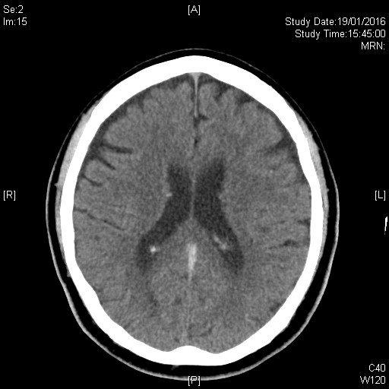
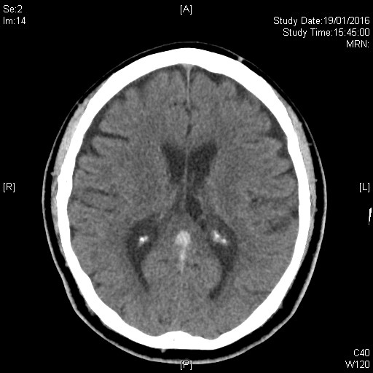
Question 2.1 What is the CT brain abnormality?

Slide 11
hyperdense in straight sinus, vein of Galen , suggestive of acute thrombosis, age related atrophic changes

Slide 12
Question2.2 What are the risk factors associated in the disease?
Question2.3 What are the other investigations?
Question 2.4 What is the treatment principle for this condition?

Slide 13
What are the risk factors associated in the disease?
Virchow's Triad
eg protein C, S deficiency, antiphospholipid syndrome, OCP, pregnancy, malginancy, injury, parameningeal infection ( ear, sinus mough face and neck ), SLE, IBD, nephrotic syndrome....etc

Slide 14
What are the other investigations?
For diagnosis, CT venogram, MR venogram
Investigate the underlying cause, such as tumor marker, immune marker

Slide 15
What is the treatment principle for this condition?
Anticoaguation. LMWH then warfarin, duration depends on the underlying risk factor
Antiepileptic.( discuss with neurologist) increase risk if focal edema, motor deficit, ischemic or haemorrhagic infarcts.
May consider thrombolysis.

Slide 16
Case 3
30 years old man found drowsy in street, with a empty bag of medicines.

Slide 17
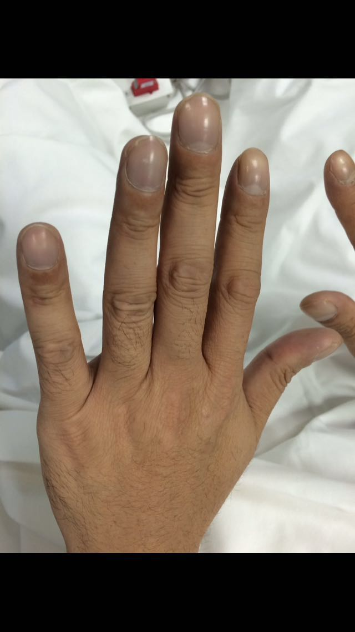
Question 3.1 Please comment on the photo.
peripheral cyanosis, clubbing of finger

Slide 18
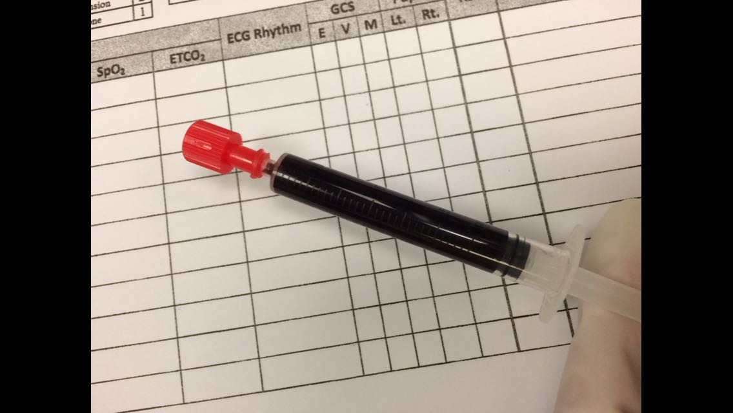
Question3.2 What are the bedside investigations?
pulse co-oximeter to see metHb. ABG analysis.
Question3.3 Please comment on the photo of his blood sample.
chocolate brown colour of blood
Notes:
Pulse-oximeter is unreliable in methemoglobinemia, as it will typically show saturation around 85%. This is because MetHb is detected by both oxyhemoglobin (940 nm) and deoxyhemoglobin (660 nm) sensors of the oximeters.
15 to 20 % MetHb level will have cyanosis, more than 25% will have symptoms with headache, more than 50% will have altered mental status . It is about symptoms of hypoxia
urine toxicology?
nitrates in vegetables; environmental and industrial chemicals (e.g. naphthalene). Drugs like Benzocaine, dapsone and Zopiclone.
Infant is more easy to suffer due to inactive cytochrome b5 MeHb reductase.

Slide 19
Question3.4 Is there any specific treatment for this condition? And what are the indications and contraindications?
methylene blue 1mg/kg over 5min if Met Hb level more than 20%,
may consider methylene blue in lower level if patient with significant comorbidities or end organ dysfunction
it is contraindicated in G6PD def. because the methylene blue need G6PD to work and it can cause hemolysis
Notes:
If the patient fails to respond to methylene blue this may reflect an incorrect diagnosis (e.g. sulfhemoglobinemia), inadequate gastrointestinal decontamination with ongoing toxin absorption, G6PD deficiency, congenital NADPH MetHb reductase deficiency or a rare toxin. In G6PD deficiency NADPH production is insufficient to reduce methylene blue to leucomethylene blue. In this situation, methylene blue therapy is not only ineffective, but may even result in higher levels of methylene blue than of leucomethylene blue leading to paradoxical methemoglobinemia.
Other treatment plasma exchange or hyperbaric o2

Slide 20
Case 4
38 years old man complaint of severe chest pain radiated to back, vital sign stable. ECG done.

Slide 21
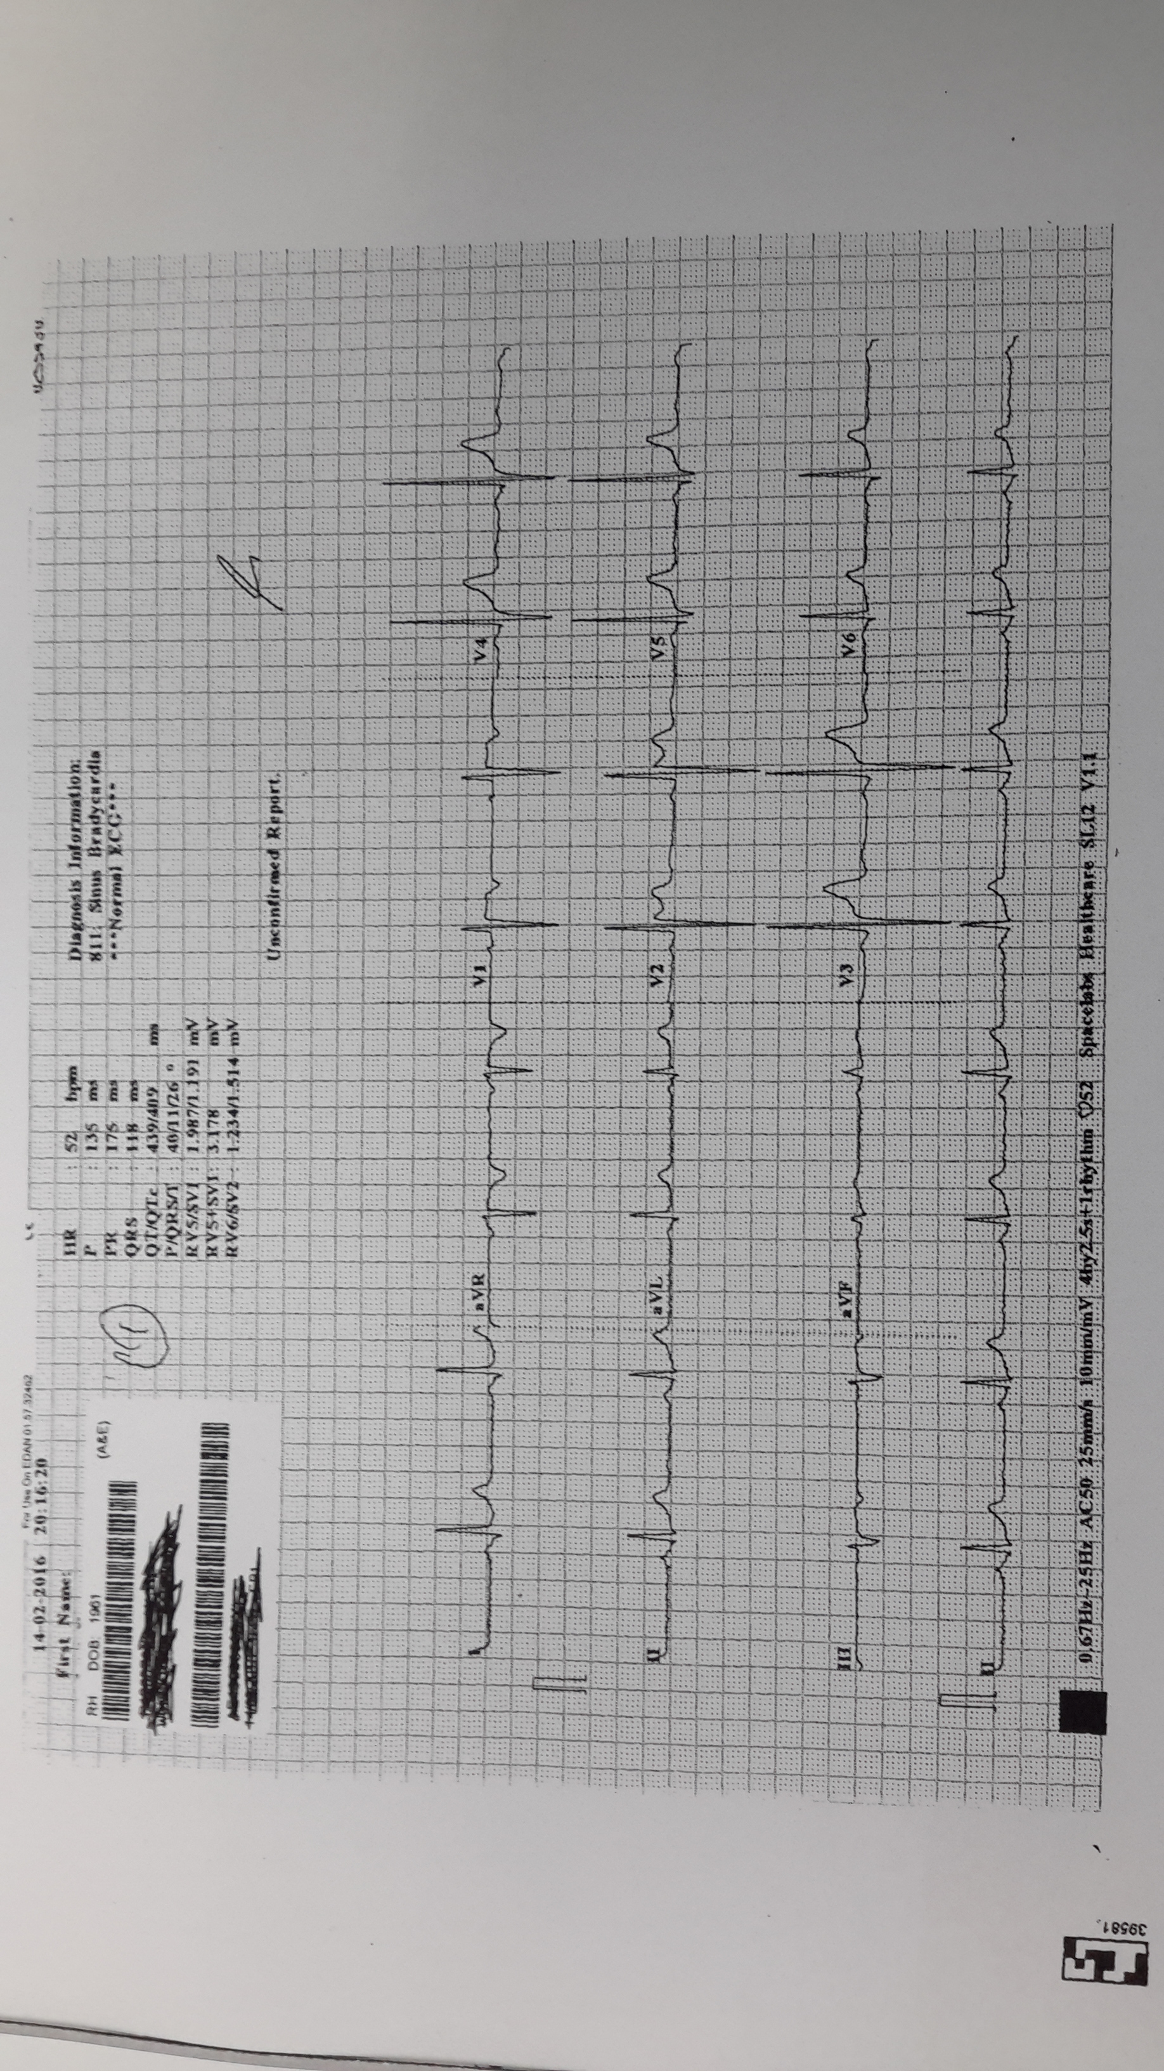
Question4.1 Please comment on the ECG, Is there any method to increase the sensitivity to catch this condition.

Slide 22
saddle type ST change on V2. brugada ECG pattern type 2
high intercostal ECG show a type1 ECG pattern had a high specificity for diagnosis of brugada synrome

Slide 23
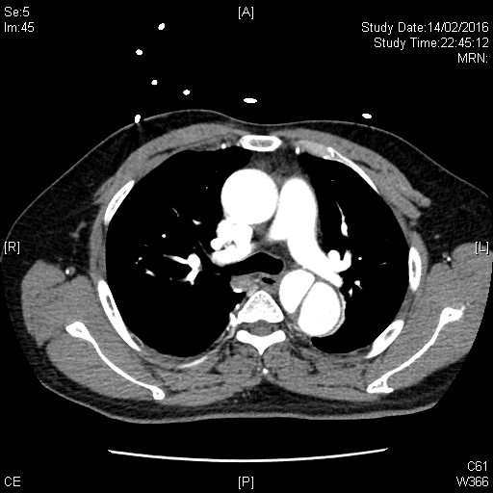
Question4.2 Please comment on the CT thorax.
false lumen in the descending aorta only.
type B aortic dissection

Slide 24
Question 4.3 What are the management in the emergency department?
Question4.4 What is the indications of surgery for the above patient?

Slide 25
What are the management in the emergency department?
pain control
reduction of systolic SBP to around 100mmHg and HR to 60/min
Intravenous Labetalol or Diltiazem and verapamil if COPD
Intravenous sodium nitroprusside
Avoid hydralazine or diazoxide, reflex incrase the HR

Slide 26
What is the indications of surgery for the above patient?
1) Distal ischaemia: viscera, kidneys, lower limbs
2) Drug resistant pain or hypertension
3) Rupture / imminent rupture
5) Expansion in length and diameter
6) Rupture

Slide 27
Case 5
65 years old man, complaint of sorethroat.

Slide 28
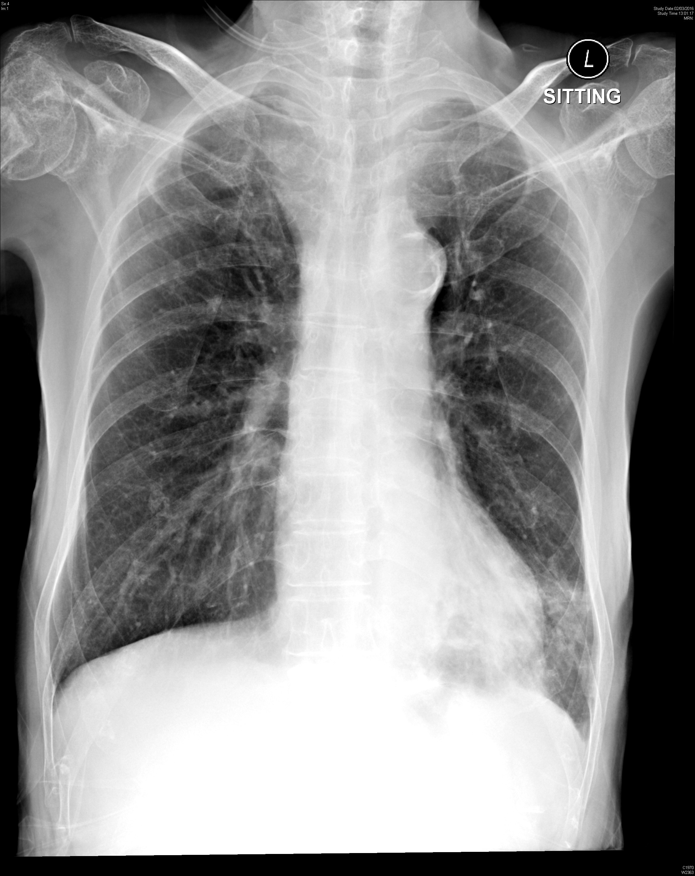
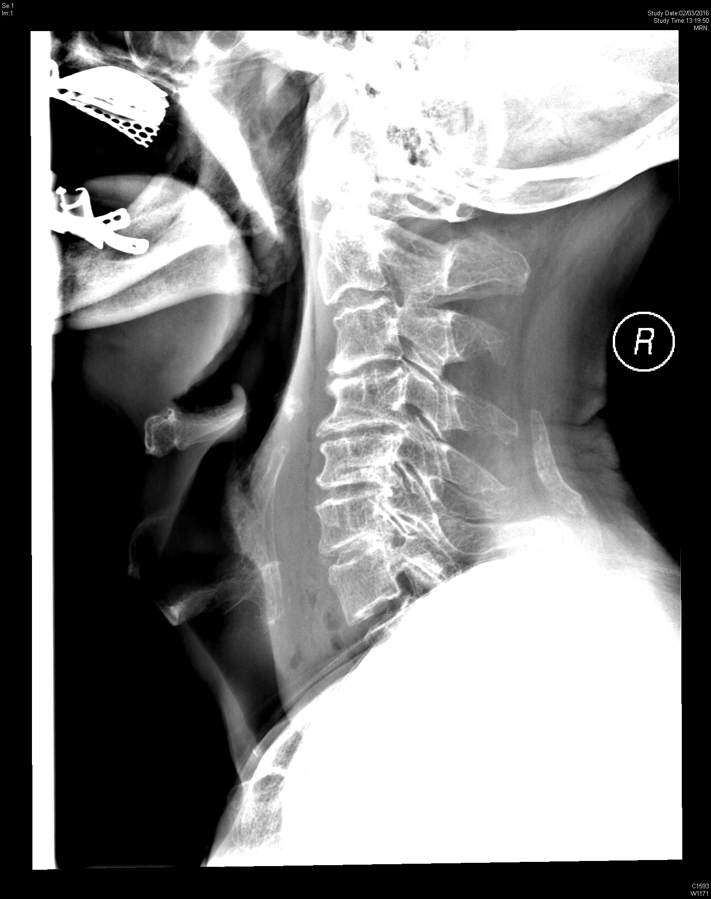
Question5.1 Please comment on the neck X ray and chest X ray

Slide 29
neck X ray , increase of retropharyngeal shadow, gas seen, no FB
Chest X ray , radio-lucent line along the left border of aorta. pneumomediastinum.
left lower zone infiltration.

Slide 30
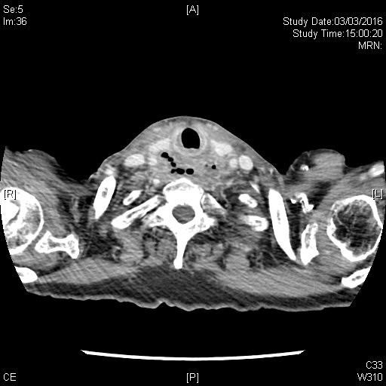
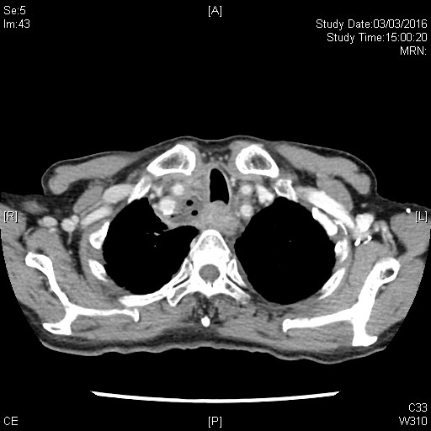
Question5.2 please comment on the CT film for her

Slide 31
low density soft tissue with air pocket in the hypopharynx
upper mediastinal abscess with air pocket

Slide 32
Question 5.3 what are the possible causes ?
Question 5.4 What are the Neck X ray finding of FBI ?
Notes:
Spontaneous pneumomediastinum. increase in intra-thoracic pressure and Valsalva maneuvers… eg asthma, cough, vomiting DO like cocaine
Boerhaave's syndrome, soft-tissue infection of head and neck by gas producing organisms, trauma and foreign body
HKCEM 2015 Jan

Slide 33
Case 6
30 years old man, both eyes were punched by the others three days ago. There is no decrease of vision acuity.

Slide 34
Qestion6.1 Please comment on the Xray.

Slide 35
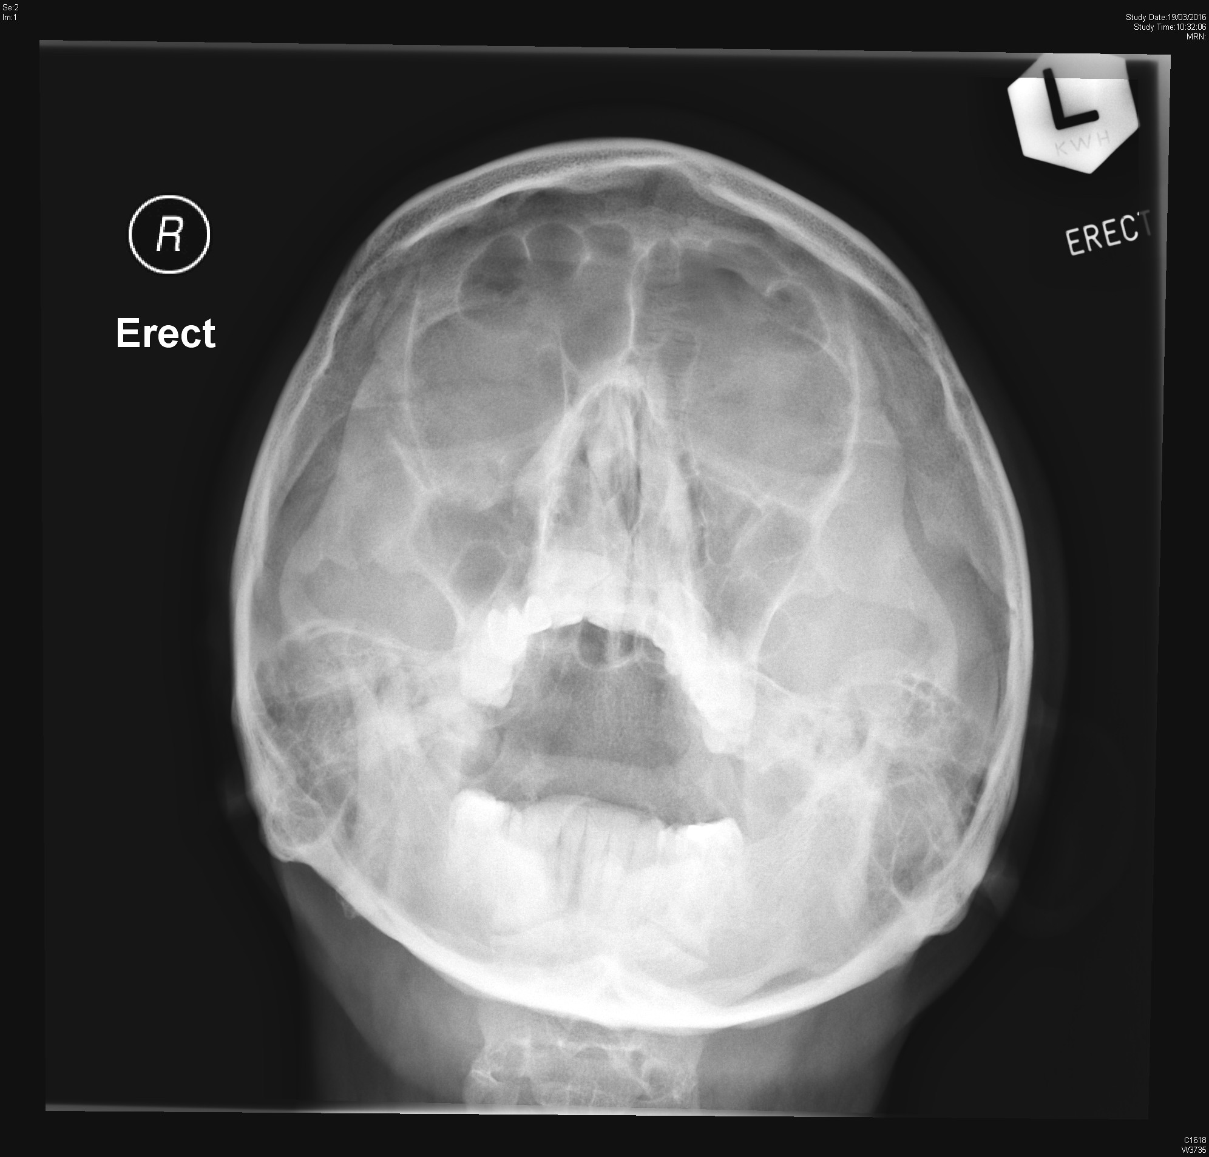

Slide 36
OM view ( water's view ) show disruption of McGrigor line 2 on right side. teardrop sign, no fluid level in maxillary sinus

Slide 37
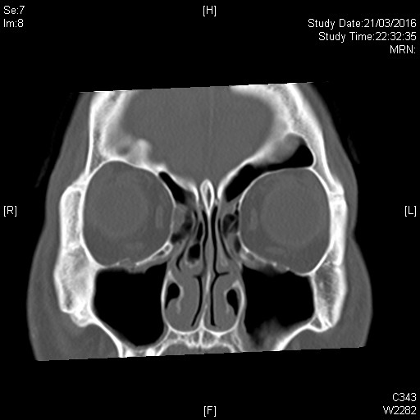
Question6.2 Please comment on the CT film
fracture right orbital floor, with no obvious entrapment of muscle, no fluid level in the maxillary sinus .

Slide 38
Question 6.3 What are the physical findings of this condition?
Tenderness or crepitus in the inferior orbital floor lost of sensation in the face diplopia

Slide 39
Question 6.4 What is the management plan for him in emergency department?
1 pain control
2 wound managment like dressing, ATT if necessary
3 Antibiotic cover
4 consider surgical therapy if significant enophthalmos, hypo-ophthalmus, entrapped inferior rectus muscle or tissue , fracture more thanan 50% of the floor, diplopia

Slide 40
Case 7
60 years old woman, left frank pain with fever for 3 days.
BP 126/75 P130 temp 38.5

Slide 41
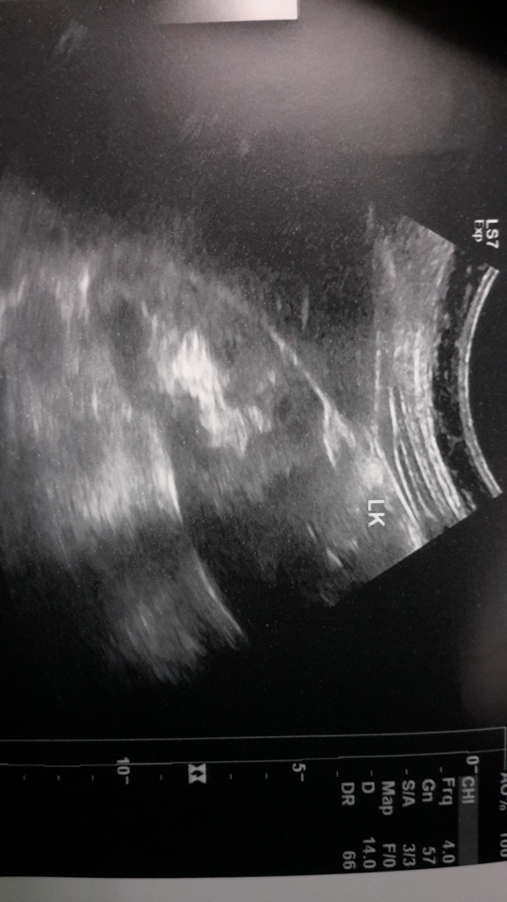
Question 7.1 Please comment on the Ultrasound. What is your diagnosis?

Slide 42
echogenic debris in collecting system
Air within renal parenchyma with reverberation artifact
emphysematous pyelonephritis

Slide 43
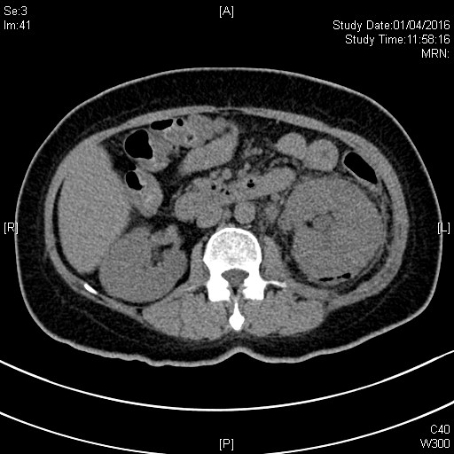
Question 7.2 Please comment on the CT film
Gross swelling of the left kidney with pocket of gas seen in renal parenchyma Perinephric fat stranding

Slide 44
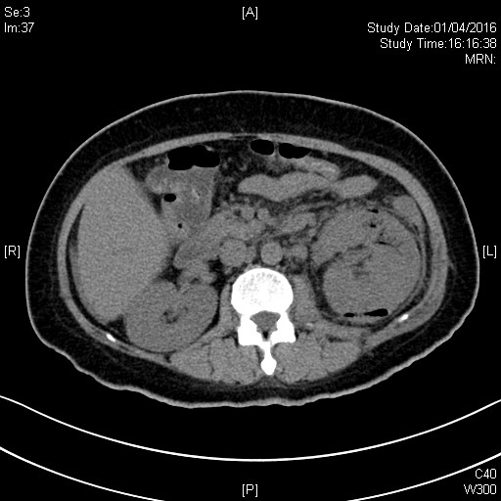
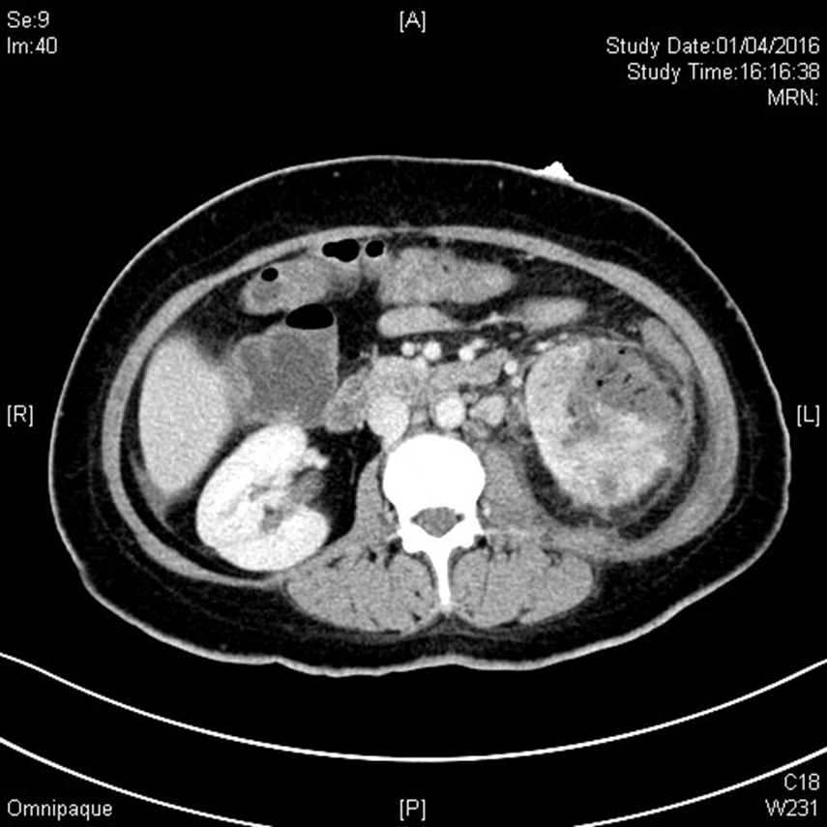
Question 7.3 please comment the CT film after few hours.

Slide 45
Interval increase in gas densities is noted in the left renal parenchyma. Wedge-shaped hypoenhancing areas are noted in left kidney,
interval progression of left emphysematous pyelonephritis +/- infarcts.

